Slide 1
Network Theorems
Chapter 9 [DC]
Chapter 18 [AC]

Slide 2
9.2 SUPERPOSITION THEOREM
2

Slide 3
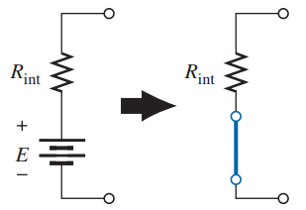
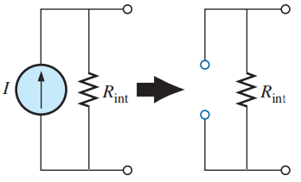
Statement of Superposition Theorem
The current through, or voltage across, an element in a linear bilateral network is equal to the algebraic sum of the currents or voltages produced independently by each source.
Steps to Apply Superposition Theorem
Step 1: | Select a single source acting alone. Short the other voltage sources to make voltage is zero and open the current sources to make current is zero, if internal resistance/impedances are not known. If known, replace them by their internal impedances.
Step 2: | Find the current through or the voltage across the required element, due to the source under consideration, using a suitable simplification technique.
Step 3: | Repeat the above two steps for all the sources.
Step 4: | Add all the individual effects produced by individual sources, to obtained the total current in or voltage across the element.
E = 0
I = 0
3

Slide 4
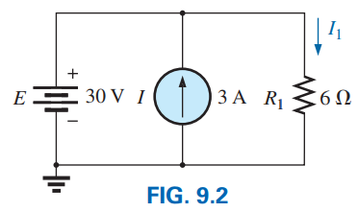
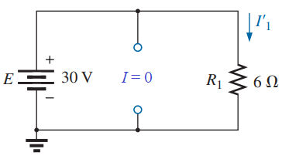

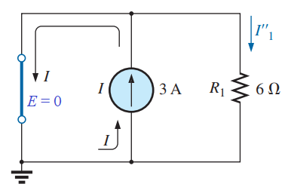


Solution: Consider E then and I = 0 A (open).
Consider I then and E = 0 V (shorted).
According to Superposition Theorem:
4

Slide 5

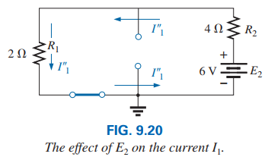
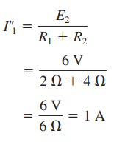
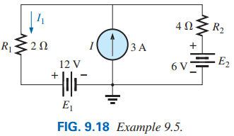
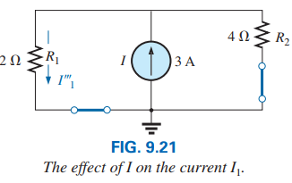
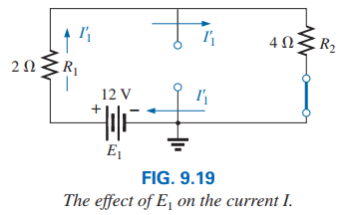
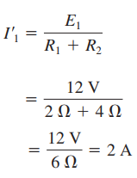
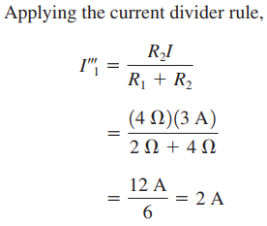
5

Slide 6
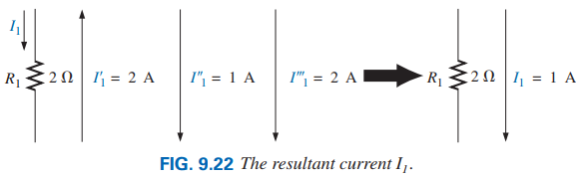
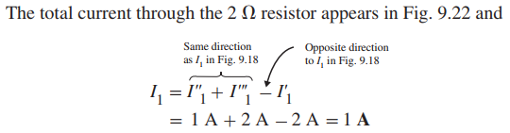
6

Slide 7
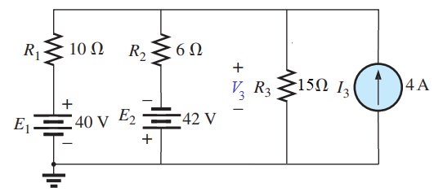
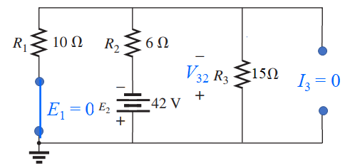
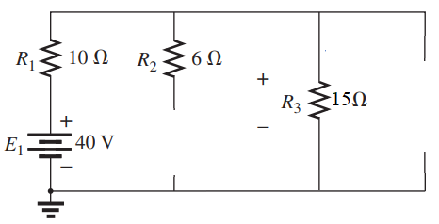
Example 9.2.1 Using superposition, find the voltage V₃ for the following network.
Consider E₂ then E₁ = 0 V (shorted) and I₃ = 0 A (open).
Solution: Consider E₁ then E₂ = 0 V (shorted) and I₃ = 0 A (open).
V₃₁
I₃ = 0
E₂ = 0
7

Slide 8
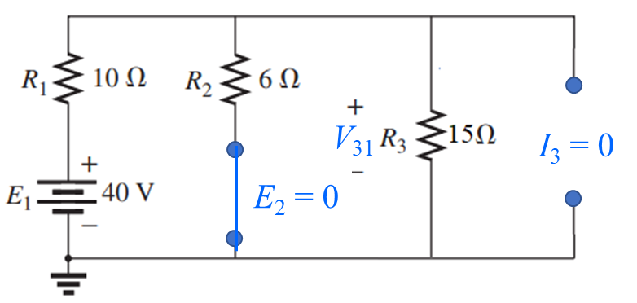
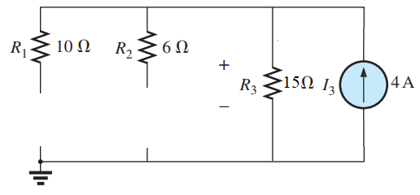
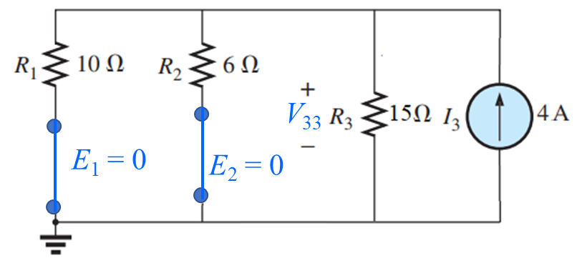
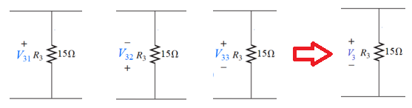
Consider I₃ then E₁ = 0 V (shorted) and E₂ = 0 V (shorted).
V₃₃
E₁ = 0
E₂ = 0
According to Superposition Theorem:
Practice Book [Ch 9] Problem: 1 ~ 6
8

Slide 9
SUPERPOSITION THEOREM [AC]
9

Slide 10
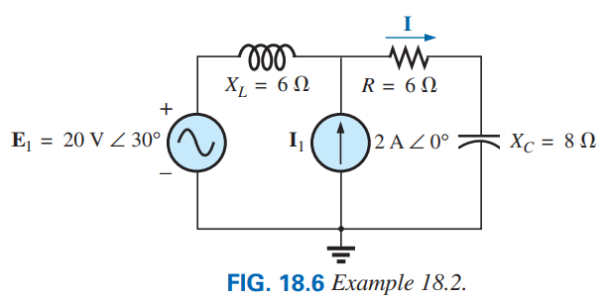
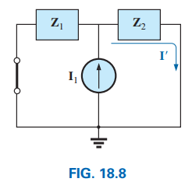

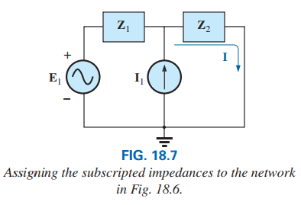
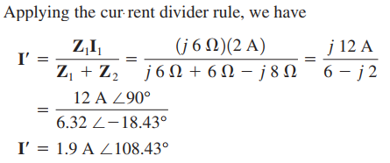
EXAMPLE 18.2: Using superposition, find the current I in Fig. 18.6.
$Z_{1}=j6 $; $Z_{2}=6 −j8 $
10

Slide 11
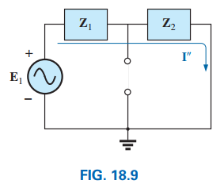

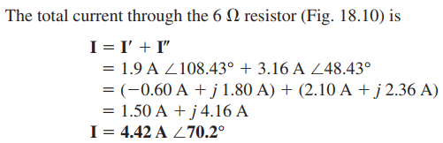
Applying the Ohm’s law give us:
11

Slide 12
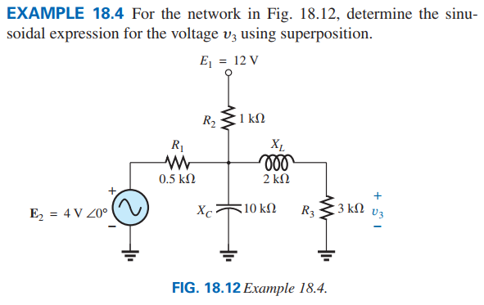
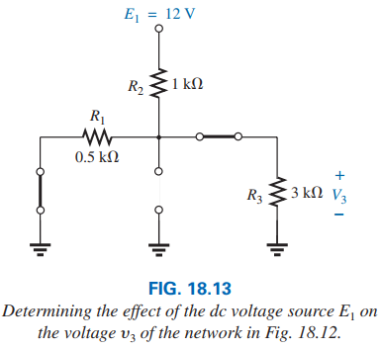


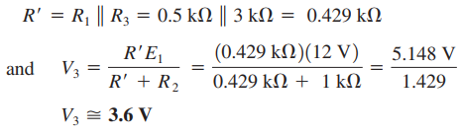
12

Slide 13
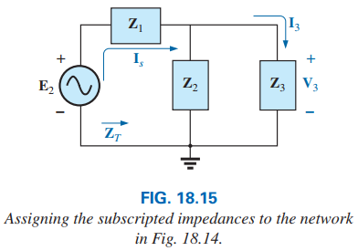
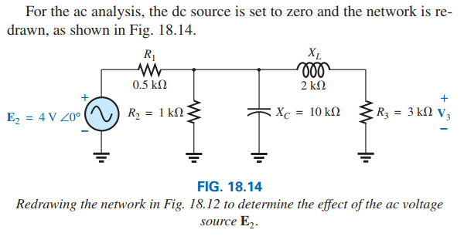



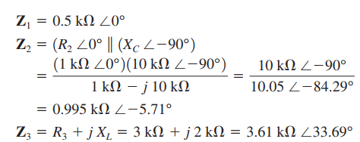
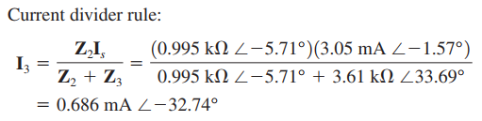
13

Slide 14
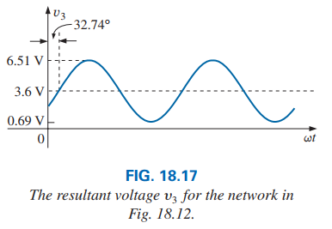

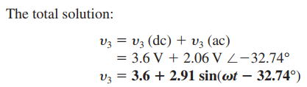

Practice Book Remaining Examples
And
Problem 1- 5 [Ch. 18]
14

Slide 15





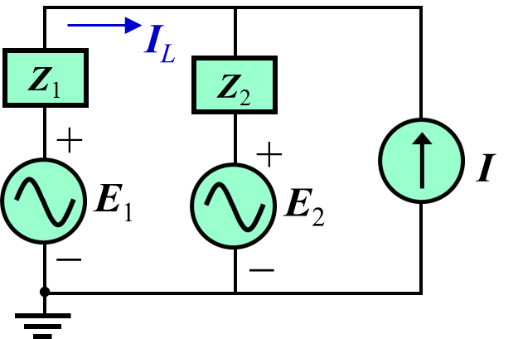
PROBLEM 2(a): Using superposition, find the current I_{L} in Fig. 18.6, where, R = 3 Ω; X_{L} = 4 Ω; E₁ = 20V∠0º; E₂ = 120V∠90º; I = 0.5A∠60º.
I_{L}
Consider E₁ = 20V∠0º:
I_{L1}
X_{L}
R
+
Z₁
Z₂
+
I
+
E₁
E₂
E₁
−
−
−
Let, Z₁ = jX_{L} = j4 Ω; Z₂ =R = 3 Ω;
Consider E₂ = 120V∠90º:
I_{L2}
Z₁
Z₂
+
E₂
−
15

Slide 16
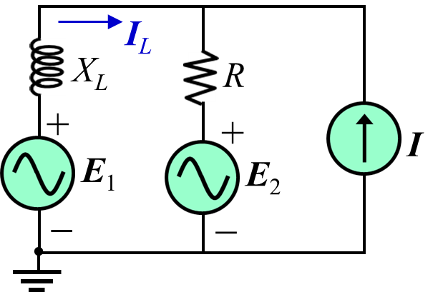
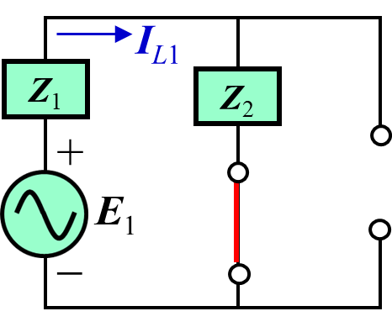
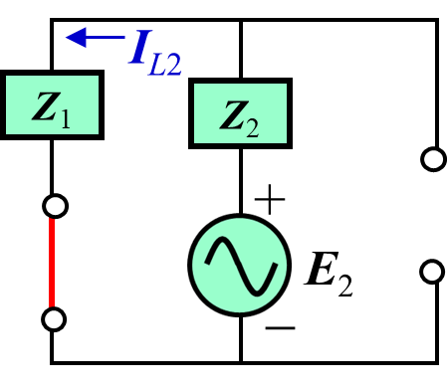
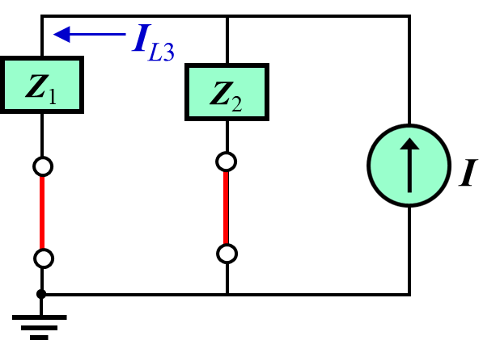
Consider I = 0.5A∠60º:
I_{L3}
Z₁
Z₂
According to Superposition Theorem:
I
16

Slide 17
9.3 THÉVENIN’S THEOREM
17

Slide 18
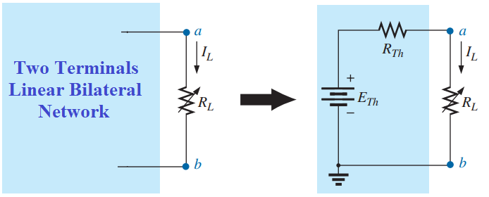
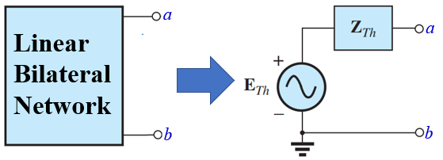
Statement of Thevenin’s Theorem
Any two-terminal, linear bilateral network can be replaced by an equivalent circuit consisting of a voltage source and a series resistance/impedance, as shown in the following figure.
R_{Th}: Thevenin’s equivalent resistance
E_{Th}: Thevenin’s equivalent voltage
Z_{Th}: Thevenin’s equivalent impedance
E_{Th}: Thevenin’s equivalent voltage
18

Slide 19
Steps to Apply Thevenin’s Theorem
Step 1: | Remove that portion of the network where the Thévenin equivalent circuit is found.
Step 2: | Mark the terminals of the remaining two-terminal network. (The importance of this step will become obvious as we progress through some complex networks.)
Step 3: | Calculate R_{Th}/Z_{Th} by first setting all sources to zero (voltage sources are replaced by short circuits, and current sources by open circuits) and then finding the resultant resistance/impedance between the two marked terminals. (If the internal resistance/impedance of the voltage and/or current sources is included in the original network, it must remain when the sources are set to zero.)
Step 4: | Calculate E_{Th} by first returning all sources to their original position and finding the open-circuit voltage between the marked terminals. (This step is invariably the one that causes most confusion and errors. In all cases, keep in mind that it is the open circuit potential between the two terminals marked in step 2.)
Step 5: | Draw the Thévenin equivalent circuit with the portion of the circuit previously removed replaced between the terminals of the equivalent circuit.
Step 6: | Do the remaining required calculation
19

Slide 20
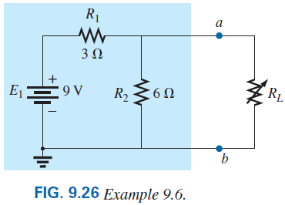
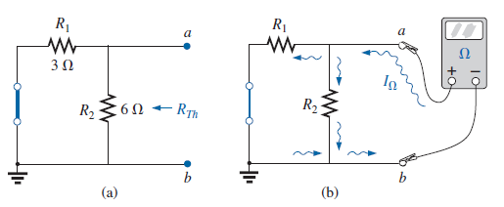
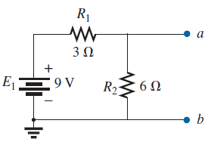
Example 9.6 Find the Thévenin equivalent circuit for the network in the shaded area of the network in Fig. 9.26. Then find the current through R_{L} for values of 2 Ω, 10 Ω, and 100 Ω.
Step 3: Calculate R_{Th} by first setting all sources to zero (voltage sources are replaced by short circuits, and current sources by open circuits) and then finding the resultant resistance between the two marked terminals (a and b).
Step 1: Remove that portion of the network where the Thévenin equivalent circuit is found.
Step 2: Mark the terminals (such as a and b) of the remaining two-terminal network.
20

Slide 21
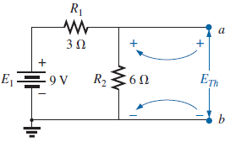
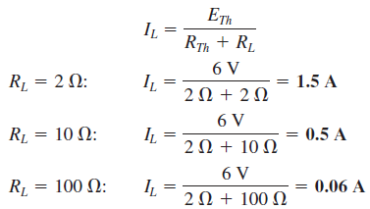

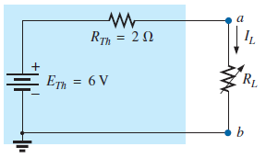
Step 4: Calculate E_{Th} by first returning all sources to their original position and finding the open-circuit voltage between the marked terminals (a and b).
Step 5: Draw the Thévenin equivalent circuit with the portion of the circuit previously removed replaced between the terminals of the equivalent circuit.
21

Slide 22
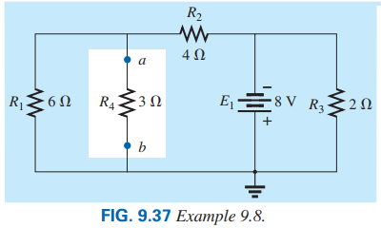



Example 9.8 Using Thevenin’s Theorem calculate the current passing through the resistor R₄.
Step 3: Calculate R_{Th} by first setting all sources to zero (voltage sources are replaced by short circuits, and current sources by open circuits) and then finding the resultant resistance between the two marked terminals (a and b).
Step 1: Remove that portion of the network where the Thévenin equivalent circuit is found.
Step 2: Mark the terminals (such as a and b) of the remaining two-terminal network.
22

Slide 23




Step 4: Calculate E_{Th} by first returning all sources to their original position and finding the open-circuit voltage between the marked terminals (a and b).
Step 5: Draw the Thévenin equivalent circuit with the portion of the circuit previously removed replaced between the terminals of the equivalent circuit.
Step 6: Calculate the current passing through the resistor R₄.
23

Slide 24




Example 9.3.1: Find the Thévenin equivalent circuit for the portions of the following network to points a and b.
Step 3: R_{Th} calculation
Step 4: E_{TH} calculation
Step 1 and Step 2:
24

Slide 25



Step 5: Draw the Thévenin equivalent circuit
Practice Book [Ch 9] Problem: 7 ~ 15
25

Slide 26
THÉVENIN’S THEOREM [AC]
26

Slide 27






27

Slide 28

28

Slide 29





29

Slide 30



Practice Book Remaining Examples
And
Problem 12- 16 [Ch. 18]
30

